Slide 1
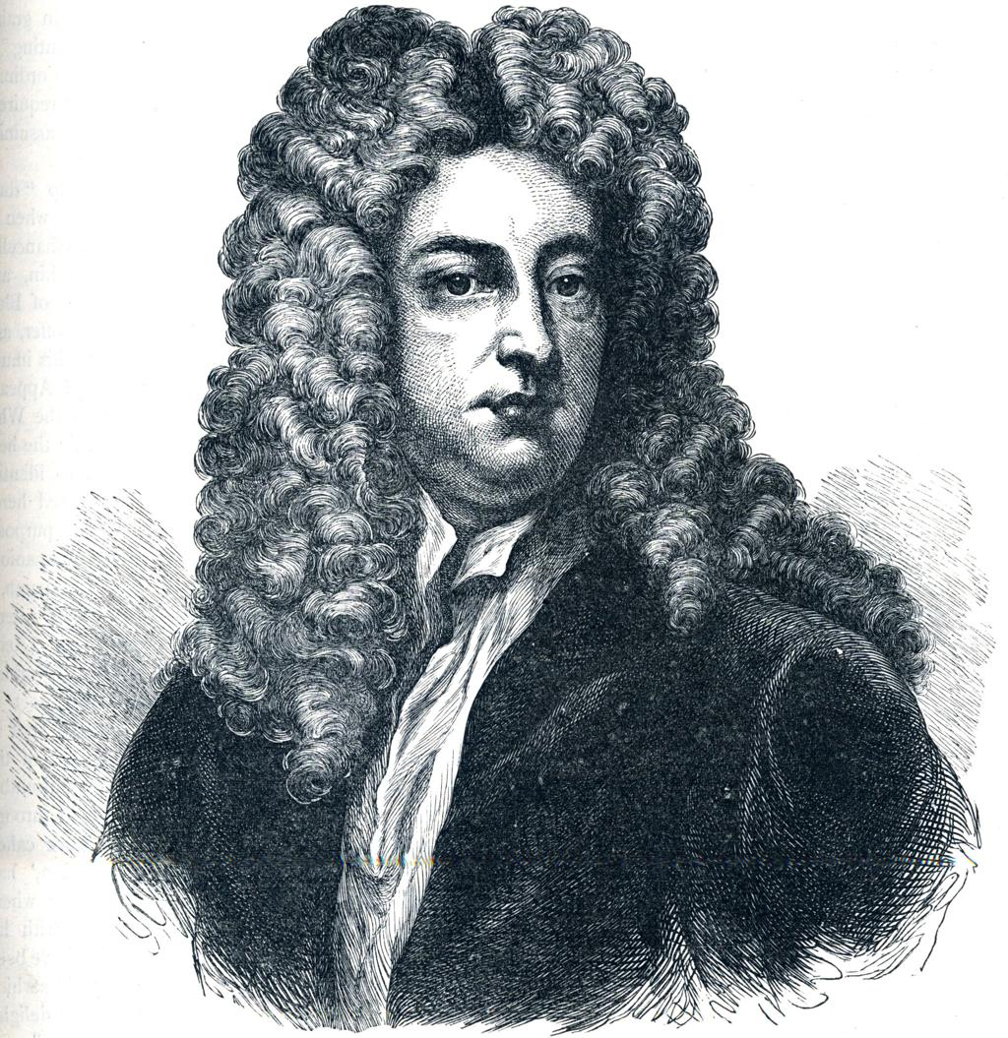
Sir Roger at Church
Joseph Addison
GE SEM I & BA SEM I
By: Prachi Ambade

Slide 2
About the Author
Sir Roger at Church
Author: Joseph Addison
Literary form: Periodical essay
Literary period: Augustan Age / Early 18th century
Subject: Religion, human nature, social customs, and country life
Joseph Addison (1672–1719)
Joseph Addison was an English essayist, poet, playwright, and politician. He was one of the leading literary figures of the Augustan Age.He is best known for his periodical essays in The Tatler and The Spectator. He worked closely with his friend Richard Steele. His essays combine humour, moral instruction, social criticism, and elegant prose.

Slide 3
Historical and Literary Background
The essay belongs to the early eighteenth century, a period associated with reason, moderation, and social refinement.
Periodical essays became popular as a means of educating and entertaining the growing reading public.
Writers discussed everyday life, manners, morality, religion, and social behaviour.
Addison used ordinary characters and familiar situations to communicate moral lessons.
The character of Sir Roger de Coverley represents traditional English country life and old-fashioned manners.

Slide 4
Introduction to the Essay
“Sir Roger at Church” is an essay from The Spectator, a periodical associated with Joseph Addison and Richard Steele.
It was published on 9 July 1711.
The essay presents a picture of village life and the importance of Sunday worship.
Sir Roger de Coverley is the central character.
Addison combines humour, social observation, and moral instruction to describe religious and social customs.
Summary — Importance of Sunday
Addison begins by praising Sundays in the countryside.
Sunday gives villagers a break from their daily work and routine.
People dress in their best clothes and gather at the village church.
Church gatherings allow them to meet neighbours, relatives, and friends.
Religious sermons remind people of their duties towards God and society.
Sunday helps improve manners, social relationships, and moral awareness.
Main idea: Sunday worship brings people together and refreshes both their minds and their social lives.

Slide 5
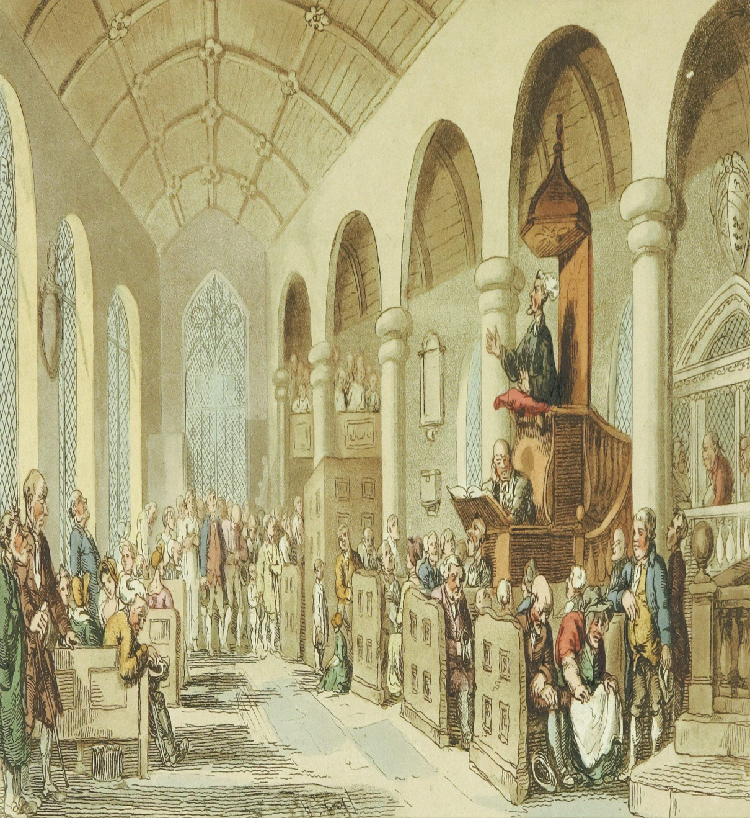
Sir Roger takes a deep interest in his village church.
He spends money on its decoration and improvement.
He provides prayer books and seating supports for his parishioners and arranges help with church singing.
During the service, he sometimes behaves in amusing and unusual ways.
He may fall asleep during the sermon but dislikes seeing others do the same.
He checks the congregation to see whether his tenants are present.
These actions reveal both his genuine concern for religion and his eccentric personality. Addison presents him with affectionate humour.

Slide 6
Addison contrasts Sir Roger's parish with a neighbouring parish.
There, the local squire and the clergyman have serious disagreements.
Their quarrels affect the villagers, who look to their social superiors for guidance.
When influential people behave badly, ordinary people may lose respect for religion and religious institutions.
Addison suggests that wealthy and influential people should set a good example for others.
Main idea: Personal disputes among leaders can damage the moral and social life of an entire community.

Slide 7
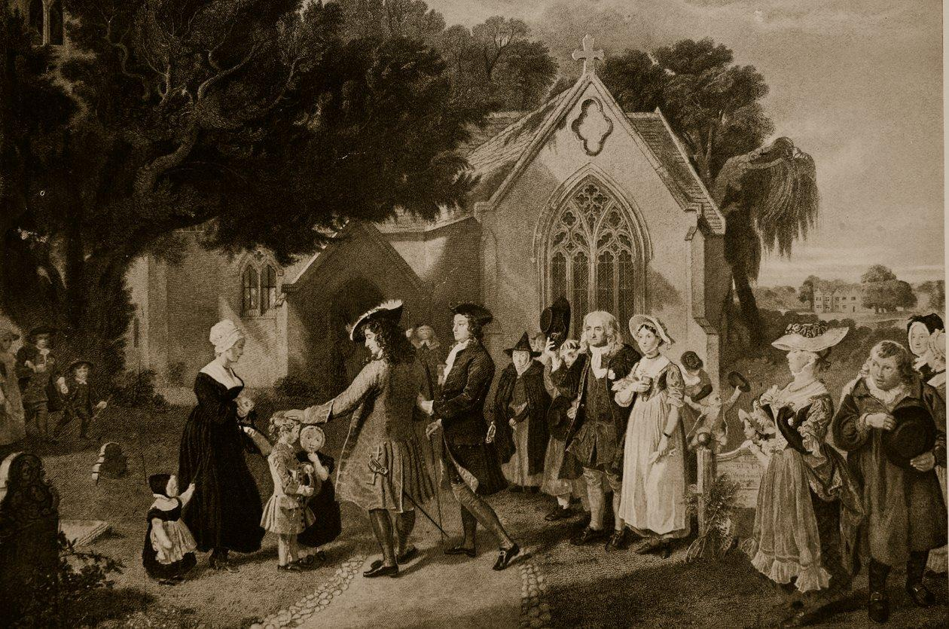
Character Sketch of Sir Roger de Coverley
A kind but eccentric country gentleman
Religious: He values church attendance and worship.
Generous: He spends his money to improve the church.
Responsible: He takes an active interest in his tenants.
Eccentric: His unusual behaviour during services creates humour.
Authoritative: He expects the villagers to follow his example.
Well-meaning: His actions are generally motivated by concern for his community.
Sir Roger is a memorable character because his admirable qualities coexist with his amusing weaknesses.

Slide 8
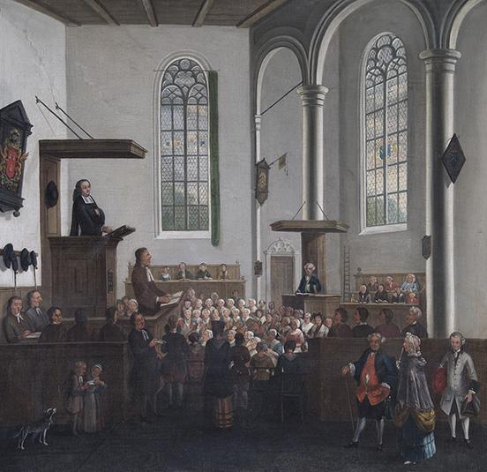
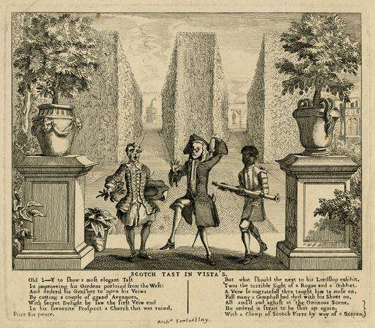
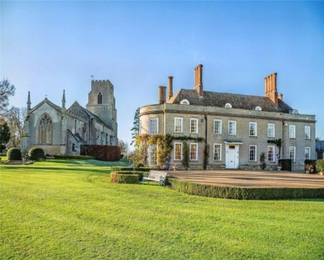
Major Themes of the Essay
1. Religion and Morality
Religion reminds people of their duties and encourages moral behaviour.
2. Community Life
Sunday worship creates opportunities for social interaction and strengthens village relationships.
3. Leadership and Responsibility
Influential people should guide their communities through responsible behaviour.
4. Humour and Human Eccentricity
Sir Roger's unusual habits entertain readers while revealing the imperfections of human nature.
5. Social Influence and Example
The behaviour of powerful people influences the beliefs and conduct of ordinary villagers.

